Slide 1
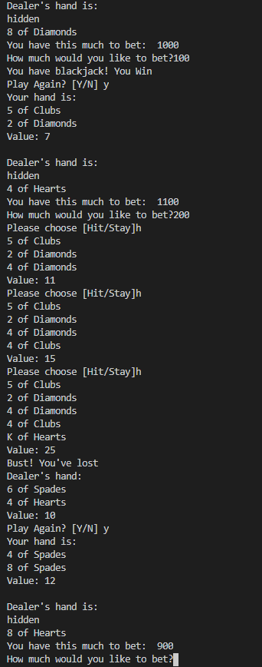
Text-Based Blackjack Game
By: Sally Luo
A simplified version of a classic casino blackjack game. The game is played through the terminal and is written in Python 3. The player and dealer is dealt 2 cards each, with one of the dealer’s being hidden. The player has the option to “hit” or “stay” after seeing the value of their cards. Classic rules apply: face cards are valued at 10, number cards are face value, and Aces can be 11 or 1 depending if paired with a face card. Player starts with a bank of 1000 and can bet to gain more. If player bank reaches 0, game ends. At the end of each round, player can see what cards the dealer had.
https://github.com/ksu-is/Text-Based-Blackjack-Game

